Slide 1
What is a network ?

Slide 2
What is a network?
In simplest form,
“A network
is a
collection and connection
of entities
located over geographical points
to
supply products or services
from one end to other end”

Slide 3
List of networks and services in day-to-day life
Service Network
Mail Postal Network / Courier
News Paper supply Local newspaper network
Milk supply Dairy network
Electricity Utility network [ BESCOM ]
Water Utility network [ BWSSB ]
Gas Utility network
Job Placement agency network
Matrimonial (? ) ……….
many more…………
Behind every service there is a network

Slide 4
What is a communication network?
“A communication network
is a set of equipment and facilities
that provides
transfer of information service
between users located at various geographical points”

Slide 5
Core philosophy of any communication
Information flow
from
via
to
Transmitting Entity
Media
Receiving Entity
using
Protocol
[ Set of agreed rules
between
two entities
to have ‘meaningful communication’ ]
Whole Networking / Communication Technology world is built on this basic phillsophy

Slide 6
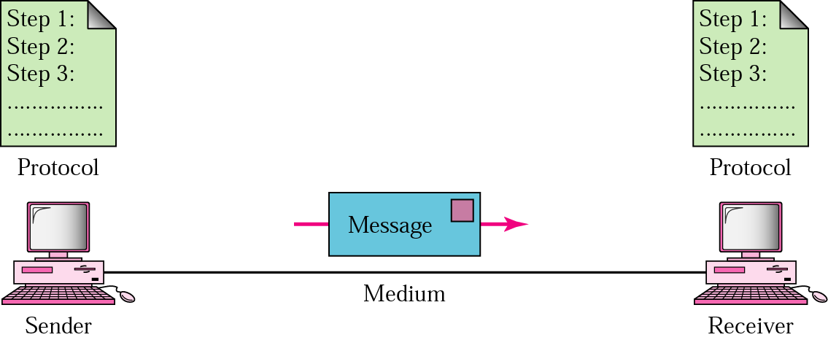
Five components of data communication
Without protocol ‘meaningful communication’ cannot happen

